Slide 1

Module 6: Using the Multi-User Development Environment
0/5
Analytics: Advanced Server Architect
Notes:
Time: Lecture: <n – n> minutes; Labs: <n – n> minutes
Intent: <What is the instructional goal of the module>
Flow: < Describe at a high level the overall flow of the module>.
Key Terms: <List terms the instructor should be familiar with in order to teach this module>
<Term>
<Term>
<Term>
<Term>

Slide 2
Module Objectives
After completing this module you will be able to:
  Identify the need for a multi-user development environment
  Implement the Siebel Analytics multi-user development environment (MUDE)
  Describe multi-user environment functionality
Why you need to know:
  Projects with multiple developers require a multi-user environment
Notes:
Each objective and “why you need to know” should be stated aloud.

Slide 3
Business Challenge
Siebel Analytics’ default configuration is for single users
  Only one user can edit the repository at a time
  Causes inefficiency while other developers wait for access to the repository

Slide 4
Business Solution: Siebel Analytics MUDE
Allows multiple users to work with the repository simultaneously
  Users edit local copies of the repository
  Changes are saved locally and then merged to the master repository
Additionally, the MUDE breaks the repository into manageable pieces known as projects
  Multiple users can work on the same or different projects
  Single users can improve efficiency by working on smaller subsets of the repository
  Projects are broken up by Presentation layer catalogs

Slide 5
Steps to Set Up a Siebel Analytics MUDE
0/3
1. Create Projects
2. Set Up a Shared Network Directory
3. Set the Multi-User Directory
Notes:
This is a structuring slide for <insert what will be discussed>. Do not teach the steps or concepts here because the following slides cover them in detail. Provide a high level description of what will be discussed.

Slide 6
1. Create Projects
1/3
Projects are subsets of the repository metadata
  Projects must be self-contained, and not refer to metadata outside the project
Projects consist of Presentation layer catalogs and their associated business model logical facts, dimensions, groups, users, variables, and initialization blocks
Projects can overlap with other projects
  For example, one table in the Physical layer may be referenced by multiple Presentation layer catalogs
Best practice: Create projects of manageable size based on individual logical stars in the business model

Slide 7
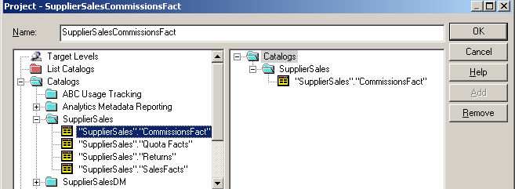
1. Create Projects Continued
1/3
Create projects by selecting Manage > Projects
Add presentation catalogs or logical fact tables to the project
  Adding a presentation catalog includes all fact tables and dependencies within the catalog
  Adding a logical fact table includes the presentation catalog containing the table
  In both cases, logical dimension tables joined to the logical fact tables are implicitly included
In the Project window, select either presentation catalogs or logical fact tables within the catalogs

Slide 8
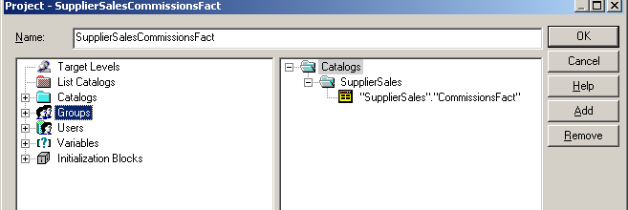
1. Edit Projects
1/3
Remove unwanted fact tables from the project
Add other metadata such as users, groups, or variables to the project
Best practice: Add the Administrators group to each project
  All developers must have Administrator privileges, so this ensures complete access to all projects
Add other metadata to the project; in particular, add Administrators group to every project
Remove unwanted fact tables

Slide 9
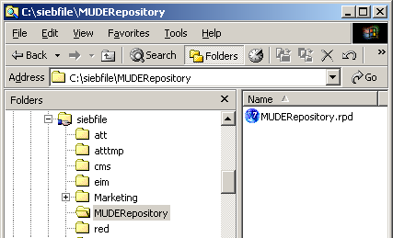
2. Set Up a Shared Network Directory
2/3
Directory contains master repository that all developers will access for checking in/checking out
  Directory must be accessible to all developers and repository servers
Copy base repository to shared network directory after creating projects
All users must have access to the shared directory
Copy the base repository to the shared directory

Slide 10
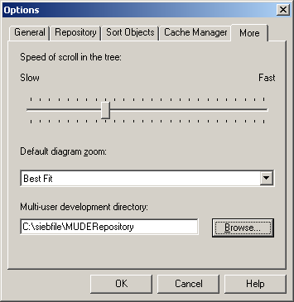
3. Set the Multi-User Directory
3/3
In the Administration Tool, select Tools > Options
Locate the multi-user development directory
Each user must specify the multi-user development directory to use the MUDE

Slide 11
Using the Siebel Analytics MUDE
0/4
Check Out Projects
Change Metadata
Check In Projects
Track Changes
Notes:
This is a structuring slide for <insert what will be discussed>. Do not teach the steps or concepts here because the following slides cover them in detail. Provide a high level description of what will be discussed.

Slide 12
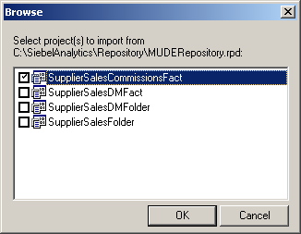
Check Out Projects
1/4
Using File > Multi-User Checkout
Select multi-user repository and project(s)
Select one or more projects to check out from the multi-user repository

Slide 13
Checking Out Projects
1/4
During checkout, the Administration Tool:
  Extracts a subset of the master repository to the local repository directory and logs the time of this extract to a local repository log
  Logs the time, projects, machine name, and user to the shared master repository log
Shared
Directory
Server
Local
Development
Machine
Master
Analytics
Repository
Extract
Repository
Local
Project
Repository
Repository Log
Repository Log
Record checkout in both logs

Slide 14
Checking Out Projects Continued
1/4
During checkout, the Administration Tool:
  Makes a backup copy of the project repository to enable comparing changed projects with original projects locally
Shared
Directory
Server
Local
Development
Machine
Master
Analytics
Repository
Local
Project
Repository
Original
Local
Repository
Repository Log
Create copy of local repository for comparison of changes
Repository Log

Slide 15
Checking Out Projects Continued
1/4
During checkout, the Administration Tool does not lock the projects on the server
  Multiple users can work on the same projects at the same time
  Conflicts are resolved during the check-in process
  Users are responsible for examining the shared directory log to determine which projects are currently checked out

Slide 16
Change Metadata
2/4
Edit metadata as you would during single-user development
Caveats:
  Hierarchy definitions should not be modified; if two users modify them concurrently, the changes will not be merged correctly
  Project definitions should not be modified locally
  Physical connection settings should not be modified, as the local machines may not have the same connections as the server
Test changes by checking in projects or by modifying NQSConfig.ini to point to the local repository

Slide 17
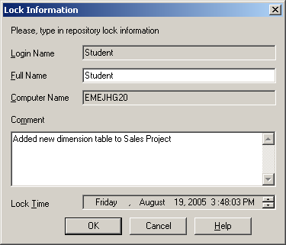
Check In Projects
3/4
Using File > Multi-User > Merge Local Changes
  Select Discard Local Changes to delete changes without saving
Specify user name and comments to lock shared repository
  Only one user may merge changes at a time

Slide 18
Checking In Projects
3/4
During Merge Local Changes, the Administration Tool:
  Locks the master repository to prevent other developers from attempting to merge at the same time
  Copies the master repository to the local directory to ensure that the developer is merging with the most recent version
Shared
Directory
Server
Local
Development
Machine
Copy
Repository
Master
Analytics
Repository
Copy of
Analytics
Repository
Project
Repository
Original
Project
Repository
Repository Log
Repository Log

Slide 19
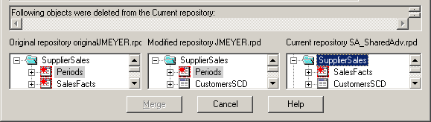
Checking In Projects Continued
3/4
During Merge Local Changes, the Administration Tool:
  Warns about added objects
    Added objects must be added to projects in the master repository to be available for multi-user development
  Merges the local project repository to the local master repository
  Uses the Merge Repositories window to show changes made by other developers while the project was checked out
3. Another developer deleted the Periods logical table and checked in the project while JMEYER had his project checked out
1. The original project contained both Periods and SalesFacts logical tables
2. JMEYER deleted the SalesFacts logical table during this checkout

Slide 20

Checking In Projects Continued
3/4
Developer must select an action for repository objects changed and checked in by other developers
  Overwrite other developers’ work by using the modified repository
  Accept other developers’ work by keeping the current repository
  Caveat: If two developers modify the same object at the same time, one developer’s changes will be lost
    Must select current or modified repository; cannot combine changes
Once changes are made, select File > Multi-User > Publish to Network to copy the merged master repository to the shared directory server
  Releases the lock on the master repository
Another developer deleted Periods while JMEYER had his project checked out
JMEYER may accept this change by selecting Current, or overwrite it by selecting Modified

Slide 21
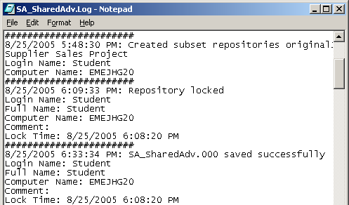
Track Changes
4/4
All checkouts, check-ins, and locks are recorded in the shared directory server’s repository log file
Every repository on the local machine has its own log file
  A log file for the local copy of the master repository
  A log file for the local repository containing the extracted projects
  A log file for the original project repository
Shared directory server’s repository log includes checked-out projects, locks, check-ins, and merges

Slide 22
Summary
This module showed you how to:
  Identify the need for a multi-user development environment
  Implement the Siebel Analytics multi-user development environment (MUDE)
  Describe multi-user environment functionality
Notes:
Review Question: <Question>
Answer: <Answer>

Slide 23
Lab
In the lab you will:
  Perform the steps to set up a multi-user environment
  Use a multi-user environment
Notes:
Labs and Troubleshooting:
<Summarize the tasks the students will perform in this lab. Suggest specific guidance the instructor may provide if necessary to help the students complete the lab and avoid trouble spots.>

